Slide 1

Prediction of Pre-eclampsia in Pregnant Women
Niyati Vikas Chopra, Jerry Adams Franklin, Manaswini Nagaraj

Slide 2
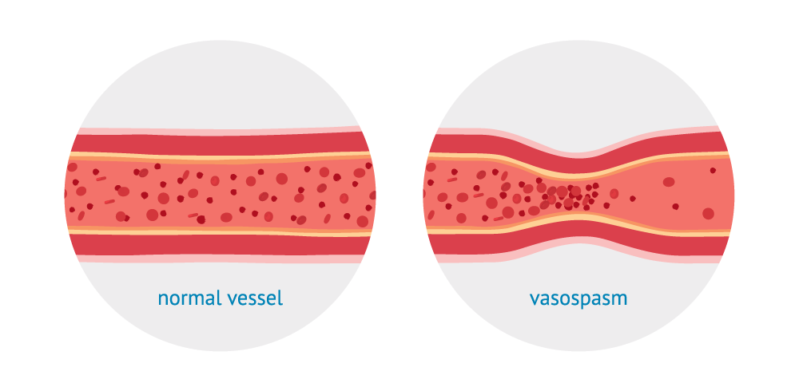
What is preeclampsia?
It is a pregnancy complication that tends to occur after 20 weeks
It is characterized by high blood pressure in the mother, along with elevated proteins in her urine
It is a type of ‘vasospasm’
This means that it causes narrowing of the arteries and blood vessels without the presence of any blockages
It can be fatal to the mother as well as the child which is why it is better to diagnose it as soon as possible and treat appropriately

Slide 3
What causes preeclampsia?
The main cause of preeclampsia is still unknown but here are some of the probable causes:
An autoimmune disorder
Genetics
Blood vessel problems
Improper development of the placenta
There also some major factors that can increase the risk of preeclampsia:
Having preexisting blood pressure, liver or kidney disorders
Being too old (above 35) or too young (below 20) when pregnant
Being pregnant for the first time
Having multiple fetuses

Slide 4
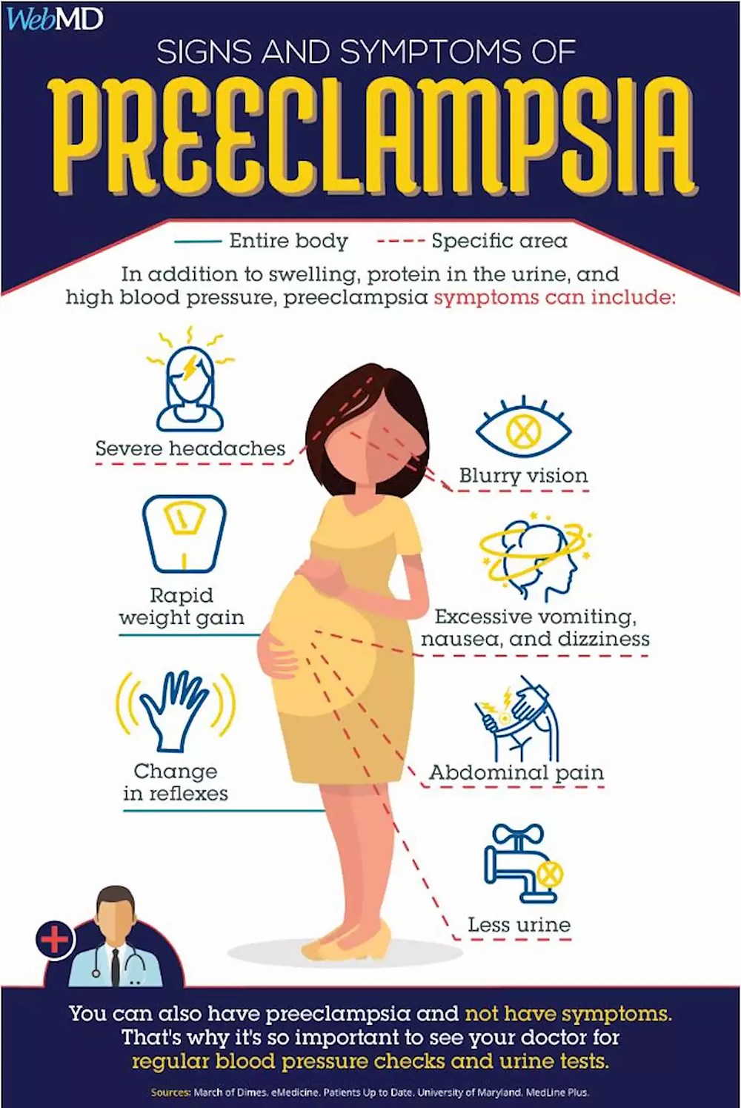
How to detect preeclampsia?
There are some tell-tail signs of preeclampsia that should be looked out for:
Persistent headaches
Abnormal swelling of hands or face
Abnormally rapid weight gain
Decrease in urine discharge
High blood pressure
Increased nausea

Slide 5
About PROTECT and the dataset
Dataset : The Puerto Rico Testsite for Exploring Contamination Threats (PROTECT) Program.
The PROTECT Center studies exposure to environmental contamination in Puerto Rico and its contribution to adverse pregnancy outcomes, including preterm birth and preeclampsia
Data variables : Maternal characteristics, Medical history, Routine prenatal check-up results, and Postpartum
This information is usually available during regular prenatal check-ups.
Early risk assessment tool that can be used to identify high-risk cases and then order further complex tests if needed.
Reduces the cost and makes the process more accessible.

Slide 6
Project methods and phases
The planning of this project is divided into four phases.
Phase 1: Requesting access to the database, completing necessary documentation to obtain it
Phase 2: Data cleaning and pre-processing and Exploratory Data Analysis using plots
Phase 3.1: Modeling - Probabilistic Naive Bayes model and a logistic regression model (baseline model) will be fitted on the clean dataset.
Phase 3.2: Other machine learning models and fit the one that we find will give the most optimal results on our dataset.
Phase 4: LIME/SHAP to interpret model results.

Slide 7
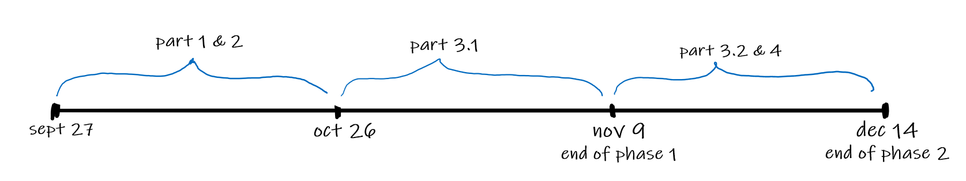
Timeline
This is an estimated timeline we hope to follow for the completion of the project:

Slide 8
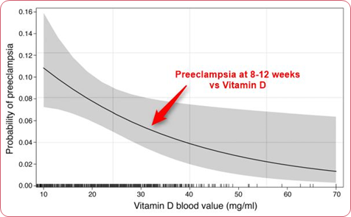
Secondary Hypothesis
We will also work on an additional hypothesis
"Whether the deficiency of calcium and vitamin D can increase the risk of preeclampsia"

Slide 9
What problems we expect to face
Noisy and missing data values
Class imbalance (if any) of the target variable
Access to more data
What additional machine learning algorithms to use

Slide 10


Thank you!

